Slide 1
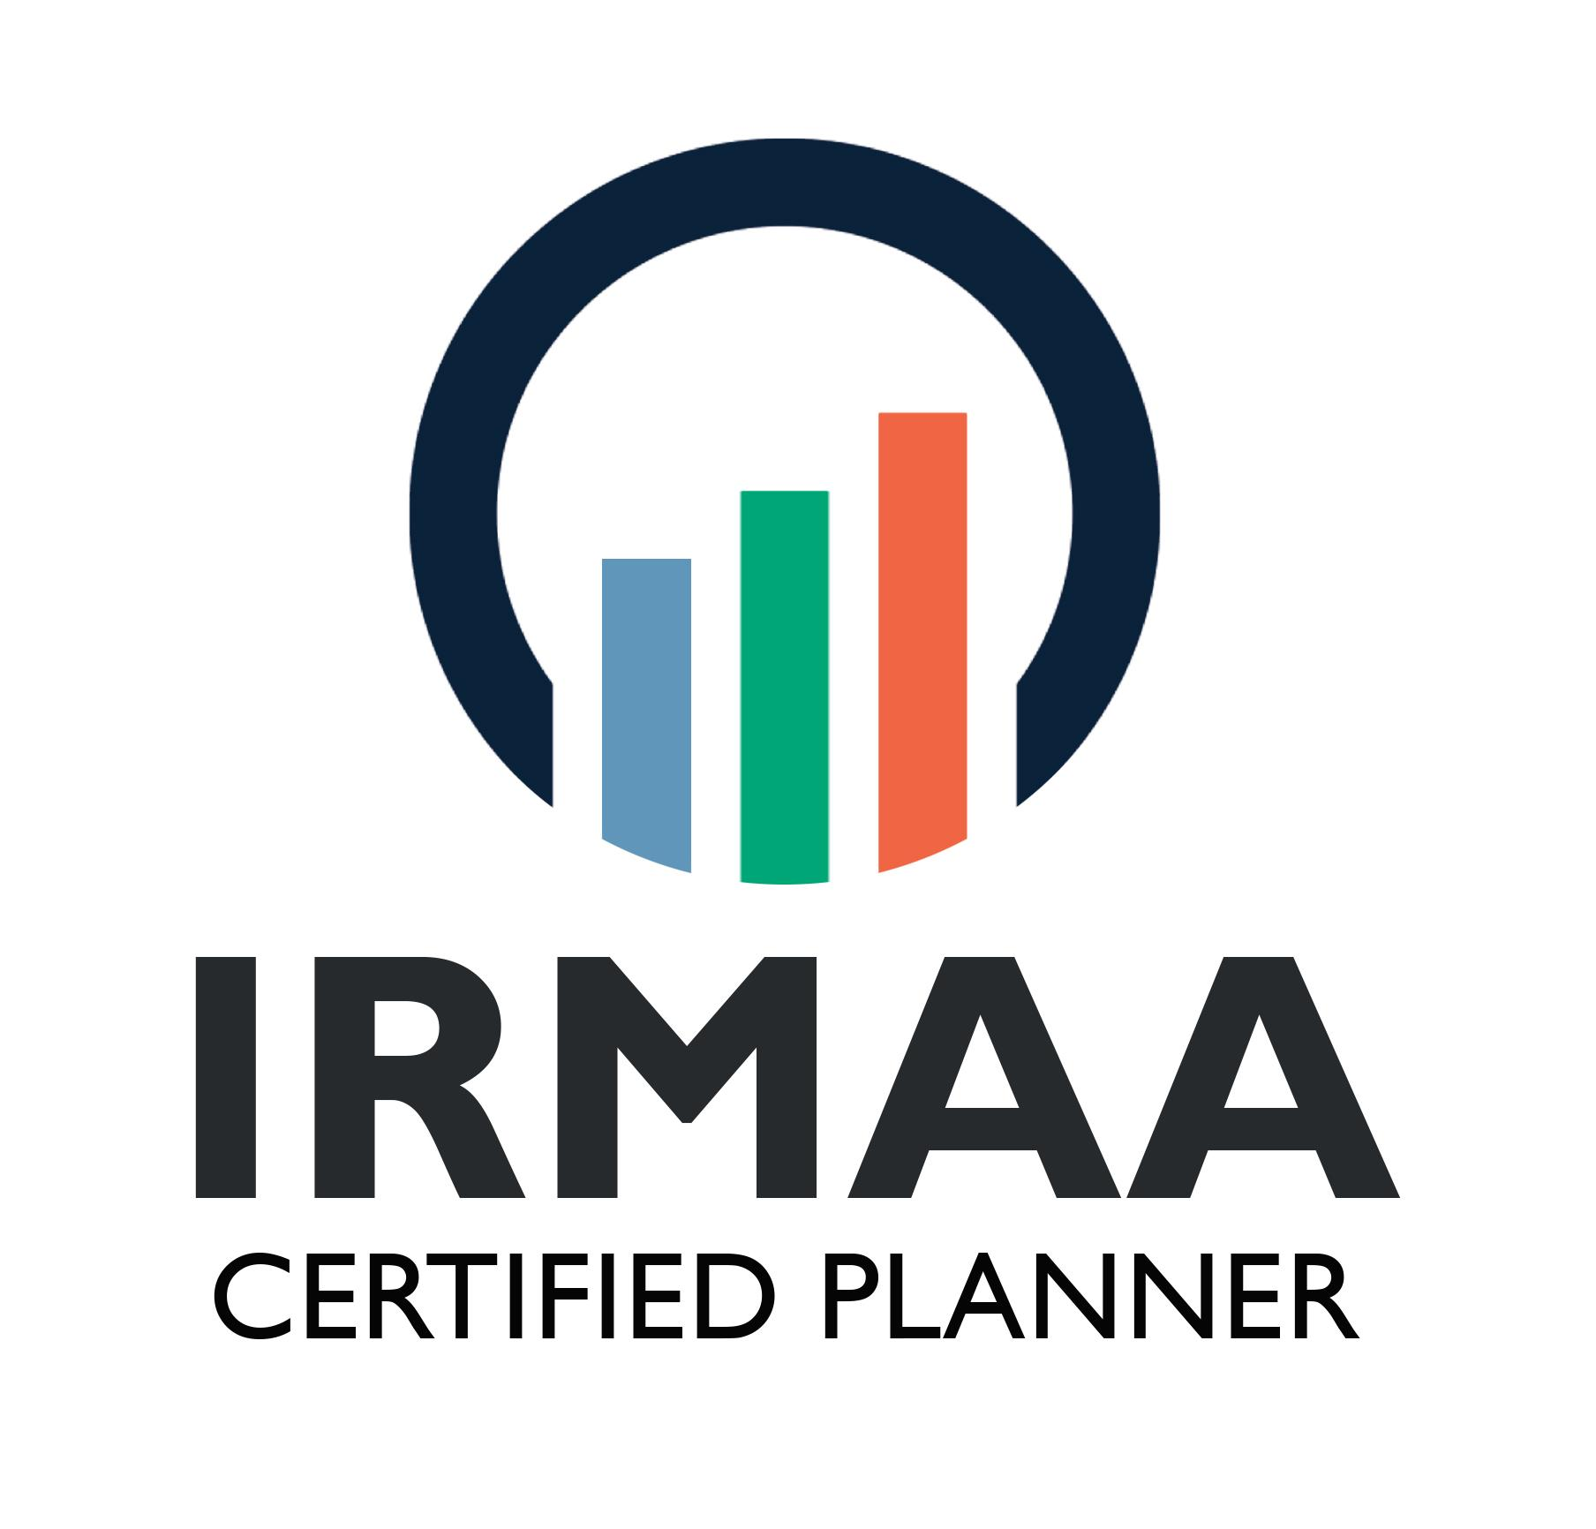
YOUR NAME
Your Company
www.yourdomain.com
copyright 2024 - IRMAA Certified Planner

Slide 2
Disclaimer
2024 Copyright © IRMAA Certified Planner, LLC. All Rights Reserved. IRMAA Certified Planner is the author of this presentation for purposes United States Copyright laws and all laws given effect thereto. This presentation including, but not limited to, the information and contents contained herein, is confidential and the proprietary property of IRMAA Certified Planner, LLC and is protected by copyright and any associated proprietary rights of IRMAA Certified Planner, LLC therewith. This presentation, in any form, is provided solely for the use of designated recipients and may not be duplicated, copied, reproduced, redistributed, republished, modified or exploited, in whole or in part, without the prior express written consent of IRMAA Certified Planner, LLC. This presentation and the content contained is provided by IRMAA Certified Planner for educational and informational purposes. Any links to third party information or websites in this presentation is provided as a courtesy for course participants. IRMAA Certified Planner, LLC. (2023). What You Don’t Know About Retirement.
copyright 2023 - IRMAA Certified Planner
Notes:
The goal of this presentation is to explain the relationship between Social Security and Medicare while detailing why planning for the right type of income has become a must

Slide 3
What is IRMAA
Medicare’s
Income Related Monthly Adjustment Amount
A surcharge above and beyond Medicare’s base premium for Parts B and D. The government determines which Medicare beneficiaries are subject to the surcharges.
Source: https://secure.ssa.gov/apps10/poms.nsf/lnx/0601101001
copyright 2024 - IRMAA Certified Planner

Slide 4
What is IRMAA
Medicare Handbook
“If your modified adjusted gross income is above a certain amount, you may pay an Income Related Monthly Adjustment Amount (IRMAA). IRMAA is an extra charge added to your premium”.
Source: https://secure.ssa.gov/apps10/poms.nsf/lnx/0601101001
Social Security Handbook
“Beneficiaries enrolled in Medicare Part B and D with modified adjusted gross incomes (MAGI) above a set threshold are required to pay a higher percentage of their total Part B and D premium costs”.
Source: https://secure.ssa.gov/apps10/poms.nsf/lnx/0601101001
Program Operations Manual System - SSA
“Medicare beneficiaries that have modified adjusted gross income (MAGI) above the threshold for their tax filing status pay an IRMAA in addition to the monthly premium.”
Source: https://secure.ssa.gov/apps10/poms.nsf/lnx/0601101001
Code of Federal Regulations
“An amount that you will pay in addition to the Medicare Part B and D standard monthly premium plus any applicable increase in that premium for your Medicare Part B and D coverage when your modified adjusted gross income is above the certain thresholds”
copyright 2024 - IRMAA Certified Planner

Slide 5
How Does IRMAA Measure Income?
Modified Adjusted Gross Income
(MAGI)
Program Operations Manual System - SSA
Adjusted Gross Income + Tax-Exempt Interest
or
Lines 2a and 11 of the IRS form 1040 in 2022
Source: https://secure.ssa.gov/apps10/poms.nsf/lnx/0601101001
copyright 2024 - IRMAA Certified Planner

Slide 6
How Does IRMAA Measure Income?
Examples of Income for IRMAA
Taxable Social Security | Qualified Annuities
Wages | Traditional 401(k) Distributions
Pension Income | Traditional IRAs Distributions
Rental Income | Traditional 403(b) Distributions
Capital Gains | Traditional 457 Distributions
Dividends (including muni’s) | Traditional SEP-IRA Distributions
Source: https://secure.ssa.gov/apps10/poms.nsf/lnx/0601101001
copyright 2024 - IRMAA Certified Planner

Slide 7
How Does IRMAA Determine Surcharges?
2024 IRMAA Brackets
Individual MAGI | Couples MAGI | Part B | Part D
< $103,000 | < $206,000 | $174.70 | Premium (varies)
$103,000 to $129,000 | $206,000 to $258,000 | $244.60 | Premium + $12.90
$129,000 to $161,000 | $258,000 to $322,000 | $349.40 | Premium + $33.30
$161,000 to $193,000 | $322,000 to $386,000 | $454.20 | Premium + $53.80
$193,000 to $500,000 | $386,000 to $750,000 | $559.00 | Premium + $74.20
> $500,000 | > $750,000 | $594.00 | Premium + $81.00
copyright 2024 - IRMAA Certified Planner

Slide 8
Medicare Inflation Rates
7.42% The historic average rate of inflation (Part B).
6.33% The projected rate of inflation (2023-2032).
Source: Medicare Board of Trustees Report / Inflation Reduction Act—2022
copyright 2024 - IRMAA Certified Planner
Notes:
Why Medicare needs to be planned for, especially if your Social Security benefit was discussed in any way:
According to the most recent Medicare Board of Trustees Report (2019) Medicare costs are projected to inflate by 5.76% on average through 2028
The 2019 MBT report is being used as the Trustees reported in 2020 and 2021 that due to Covid and changes to the program "the Trustees believe that it is not possible to adjust the estimates accurately at this time".

Slide 9
Current and Future Impact of IRMAA
Are you really going to be in IRMAA
 | Part B | Part D | Revenue
2022 | 5.3 Million | 4.5 Million | $16.1 Billion
2023 | 6.8 Million | 5.8 Million | $20.6 Billion
2024 | 7.6 Million | 6.5 Million | $23.4 Billion
2025 | 8.3 Million | 7.1 Million | $27.4 Billion
2026 | 9.1 Million | 7.8 Million | $32.3 Billion
2027 | 9.9 Million | 8.5 Million | $37.8 Billion
2028 | 10.8 Million | 9.3 Million | $43.3 Billion
2029 | 11.7 Million | 10 Million | $49.8 Billion
2030 | 12.6 Million | 10.8 Million | $56.4 Billion
2031 | 13.5 Million | 11.6 Million | $63.8 Billion
$355 BILLION
Source Medicare Board of Trustees - 2022
copyright 2024 - IRMAA Certified Planner

Slide 10
The Relationship between Social Security and Medicare
In order to receive Social Security benefits you must accept Medicare Part A when eligible
The bulk of Medicare premiums are deducted automatically from any Social Security benefit being received
Source: www.congress.gov/bill/114th-congress/house-bill/3696
copyright 2024 - IRMAA Certified Planner
Notes:
Again there is a unique relationship between Social Security and Medicare.
You can't have Social Security without Medicare and Medicare happens to be automatically deducted from Social Security benefits
What is also known is that Social Security benefits COLA is projected to be 2.4% while Medicare is growing is at just under 6.0% so it would be expected that for many their Social Security benefit would actually decrease over time, but thankfully there is the Hold Harmless Act
Under this Act (read slide)
So , again, thankfully, no one can see a decrease in Social Security benefits due to Part B premium increases, but the issue just happens to be that no one’s Social Security benefit will actually increase to keep up with inflation.

Slide 11
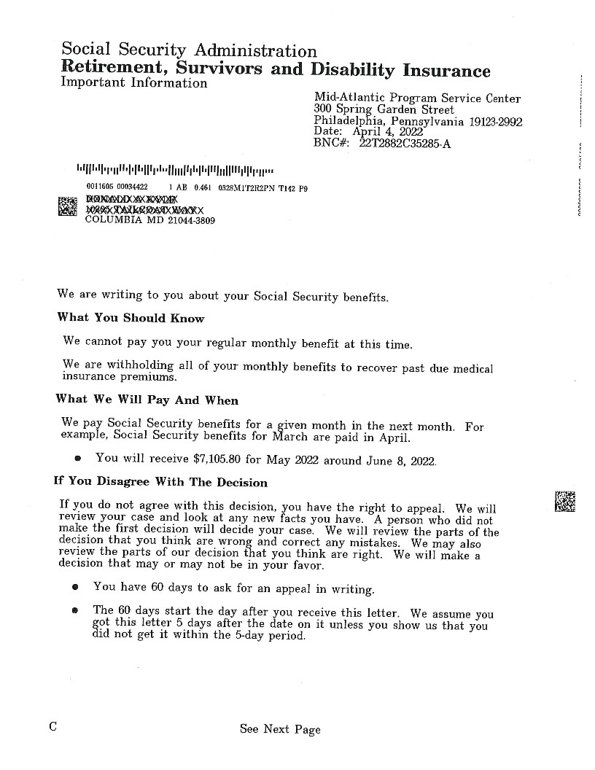
IRMAA Example Letter
Medicare Premiums being deducted from Social Security Benefit
copyright 2024 - IRMAA Certified Planner
Notes:
Here is a letter from the Social Security Administration informing an enrollee who lives in Maryland that they have lost 100% of their Social Security benefit - reason this happened - their health insurance through Medicare

Slide 12
Paying for IRMAA
Cost of living adjustment (COLA)
Increases to Social Security benefits to help offset the rate of inflation.
Typically based off the consumer price index for urban wage earners and clerical workers (CPI-U)
Source: Social Security.gov
copyright 2024 - IRMAA Certified Planner
Notes:
Once receiving Social Security benefits each year, depending on the rate of inflation, typically the CPI-U, benefits are adjusted upwards through the cost of living adjustment (COLA)
Ultimately, each year there is a possibility for SS benefist to increase from the previous year

Slide 13
Paying for IRMAA
Projected maximum COLA
2023 | 8.70%
2024 | 3.20%
2025 | 2.40%
2026 | 2.40%
2027 | 2.40%
2028 and later | 2.40%
Source: https://www.ssa.gov/OACT/TR/TRassum.html
copyright 2024 - IRMAA Certified Planner
Notes:
According to the Social Security Board of Trustees the projected COLA moving forward starting in 2023 will be no higher than 2.4%. This COLA is one of the reasons as to why a conversation with a financial professional must happen before maximizing any Social Security benefit.
Keep in mind that it is about trying to maximize the right kind of income

Slide 14
Paying for IRMAA
Hold Harmless Act (1984)
No retiree who is enrolled into Medicare and Social Security can see their Social Security benefit decreased due to Medicare Part B increases.
Must be under Medicare’s IRMAA limit (2009)
However, once you reach an IRMAA Bracket, the Hold Harmless Act no longer applies.
Source: www.congress.gov/bill/114th-congress/house-bill/3696
copyright 2024 - IRMAA Certified Planner
Notes:
Again there is a unique relationship between Social Security and Medicare.
You can't have Social Security without Medicare and Medicare happens to be automatically deducted from Social Security benefits
What is also known is that Social Security benefits COLA is projected to be 2.4% while Medicare is growing at just under 6.0% so it would be expected that for many their Social Security benefit would actually decrease over time, but thankfully there is the Hold Harmless Act
Under this Act (read slide)
So , again, thankfully, no one can see a decrease in Social Security benefits due to Part B premium increases, but the issue just happens to be that no one’s Social Security benefit will actually increase to keep up with inflation.

Slide 15
Paying for IRMAA
Thank you
What Happens when your Medicare Premiums are Higher than your Social Security Benefit?
copyright 2024 - IRMAA Certified Planner
Notes:
Read slide

Slide 16
IRMAA Example Letter
Total loss of Social Security Benefit including requirement for premium payment
copyright 2024 - IRMAA Certified Planner
Notes:
The goal of this presentation is to explain the relationship between Social Security and Medicare while detailing why planning for the right type of income has become a must

Slide 17
How Can We Mitigate IRMAA?
Income Ignored by IRMAA
Roth Accounts (Employer and Individual)
Certain Life Insurance Policies
Specific Annuities
401(h) Plans
Health Savings Accounts (HSA’s)
Home Equity
copyright 2024 - IRMAA Certified Planner
Notes:
So what doesn't count as income towards IRMAA as well as the taxation of Social Security benefits

Slide 18
Thank you
Thank you.
YOUR NAME
Phone: xxx-xxx-xxxx
Email: you@yourdomain.com
www.yourdomain.com
Notes:
Read slide

